Slide 1

Course Teacher: Prof. Dr. Israt Jahan

Slide 2
Memory Organization
Memory Unit is the integral part of any microcomputer
system and its purpose is to hold program and data.
In broad sense, microcomputer memory system can be
logically divided into 3 groups.
    Processor memory
    Primary or main memory
    Secondary memory
Processor memory refers to microprocessor’s
registers.
These registers hold temporary results when a
computation is in progress.

Slide 3
Also, no speed disparity between these registers and
the microprocessor because they are fabricated using the
same technology.
Cost involvement forces only a few register (8 & 16) in the
microprocessor.
Primary or main memory holds programs & data.
The microprocessor can directly access that are stored in
primary memory. Therefore all programs & data must be
within the primary memory prior to execution.

Slide 4
Secondary memory refers to the storage medium comprising
slow devices (Magnetic tape & disks).
They hold Large data files & huge programs (compilers &
data base management systems which are not needed by the
Processor frequently).
Secondary memories are also referred to as auxiliary backup or
virtual memory.
Microprocessor can not directly execute program stored in S.M.
It must transferred to main memory by system program (O/S).

Slide 5
PRIMARY MEMORY
RAM
ROM
Magnetic
Core
Semiconductor
Bipolar
MOS
Static
Dynamic
Mask
ROM
PROM
Mask
ROM
PROM
EPROM
And
EAROM

Slide 6
Primary memory includes ROM & RAM
ROM Permits read access (mask programmable ROMs)
Information Stored in random access memories will be lost if
the power is turned off.
This property is known as volatility and, hence, RAMs
are usually called volatile memory.
RAMs can be backed up by batteries for a certain period of time
Stored information in a magnetic tape or magnetic disk is
not lost when the power is turned off.
RAMs can be backed up by batteries for a certain period of time
and are sometimes called nonvolatile RAMs.

Slide 7
Some ROMs can be reprogrammed, these are called Erasable
Programmable Read-Only Memories(EPROMs).
In an EPROM, programs are entered using electrical impulses
and the stored information is erased by using ultraviolet rays.
With the advance in IC technology, it is possible to achieve an
electrical means of erasure . These new ROMs are called
Electrically Alterable ROMs (EAROMs) or Electrically Erasable
PROMs (EEPROMs).
Some RAMs are constructed using bipolar transistors,
and the information is stored in the form of voltage levels in
Flip-flops.

Slide 8
These voltage levels do not usually drift away, or decay. Such
Memories are called static RAMs.
In RAMs that are designed using MOS transistor, the information
held in the form of electrical charges in capacitors. Here, the
stored charge has has the tendency to decay.
Therefore, a stored 1 would become 0 if no precautions were
taken.
In order to prevent any information loss, dynamic RAMs have
to be refreshed at regular intervals.
Refreshing means boosting the signal level and writing it back.
This activity is performed by a hardware unit called “refresh
logic’ which can either be a separate chip or is contained in the
Microprocessor chip.

Slide 9
Main Memory array design
In many application, a memory of large capacity is often realized
by interconnecting several small-size memory blocks.
3 types of techniques used for designing the main memory.
Linear decoding
Full decoding /partial decoding &
Memory decoding using PALs.

Slide 10
First, consider the block diagram of typical static RAM Chip as shown below.
Capacity of this chip 8192 bits are organized as 1024 words with 8 bits / word
Each word has a unique address and this is specified on 10 bit address lines
A₉ - A₀.
A₉-A₀ 10 | 1K X 8 RAM chip
WE |  |  | D7 - DO
CS
Fig: Typical Static RAM chip

Slide 11
The inputs and outputs are routed though the 8 bit bidirectional
data lines D7 though D0.
The operation of this chip is governed by the two control units:
WE and CS
The truth table describes the operation of this chip.
Table: Truth table for 1K X 8 static RAM
CS | WE | MODE | Status of D7-D0 | Power
L | X | Not selected | High impeduce | Standby
H | L | Write | Acts as input bus | Active
H | H | Read | Acts as output bus | Active
H- High, L- Low, X- don’t care

Slide 12
Linear decoding
This technique uses the unused address lines of the
microprocessor as chip selects for the memory chips.
This method is used for small systems.
A simple way to connect an 8 bit microprocessor
to a 6k RAM system using linear decoding is shown as follows.
In this approach, the address lines A₉ though A₀ of the
microprocessor are used as a common input to each
1K x 8 RAM chip.
The remaining 6 high – order lines are use to select one
of the 6 RAM chips.

Slide 13
A 8bit microprocessor interfaced to a 6K RAM system using the linear select decoding technique.
8 bit microprocesso r
A₁₅ A₁₄ A₁₃ A₁₂ A₁₁ A₁₀ A₉ – A₀ R/W
 |  |  |  |  |  | 10
 |  |  |  |  |  |  |  |  |  |  |  |  | RAM chip 0
 |  |  |  |  |  |  |  |  |  |  |  |  | 1K x 8
 |  |  |  |  |  |  |  |  |  |  |  |  | A₉ - A₀ |  |  |  |  |  |  |  | 8
 |  |  |  |  |  |  |  |  |  |  |  |  | WE |  |  | D₇ - D₀
 |  |  |  |  |  |  |  |  |  |  |  |  | CS
 |  |  |  |  |  |  |  |  |  |  |  |  | RAM chip 1
 |  |  |  |  |  |  |  |  |  |  |  |  | 1K x 8
 |  |  |  |  |  |  |  |  |  |  |  |  | A₉ - A₀ |  |  |  |  |  |  |  | 8
 |  |  |  |  |  |  |  |  |  |  |  |  | WE |  |  | D₇ - D₀
 |  |  |  |  |  |  |  |  |  |  |  |  | CS
 |  |  |  |  |  |  |  |  |  |  |  |  | RAM chip 2
 |  |  |  |  |  |  |  |  |  |  |  |  | 1K x 8
 |  |  |  |  |  |  |  |  |  |  |  |  | A₉ - A₀ |  |  |  |  |  |  |  | 8
 |  |  |  |  |  |  |  |  |  |  |  |  | WE |  |  | D₇ - D₀
 |  |  |  |  |  |  |  |  |  |  |  |  | CS
 |  |  |  |  |  |  |  |  |  |  |  |  | RAM chip 3
 |  |  |  |  |  |  |  |  |  |  |  |  | 1K x 8
 |  |  |  |  |  |  |  |  |  |  |  |  | A₉ - A₀ |  |  |  |  |  |  |  | 8
 |  |  |  |  |  |  |  |  |  |  |  |  | WE |  |  | D₇ - D₀
 |  |  |  |  |  |  |  |  |  |  |  |  | CS
 |  |  |  |  |  |  |  |  |  |  |  |  | RAM chip 4
 |  |  |  |  |  |  |  |  |  |  |  |  | 1K x 8
 |  |  |  |  |  |  |  |  |  |  |  |  | A₉ - A₀ |  |  |  |  |  |  |  | 8
 |  |  |  |  |  |  |  |  |  |  |  |  | WE |  |  | D₇ - D₀
 |  |  |  |  |  |  |  |  |  |  |  |  | CS
 |  |  |  |  |  |  |  |  |  |  |  |  | RAM chip 5
 |  |  |  |  |  |  |  |  |  |  |  |  | 1K x 8
 |  |  |  |  |  |  |  |  |  |  |  |  | A₉ - A₀ |  |  |  |  |  |  |  | 8
 |  |  |  |  |  |  |  |  |  |  |  |  | WE |  |  | D₇ - D₀
 |  |  |  |  |  |  |  |  |  |  |  |  | CS

Slide 14
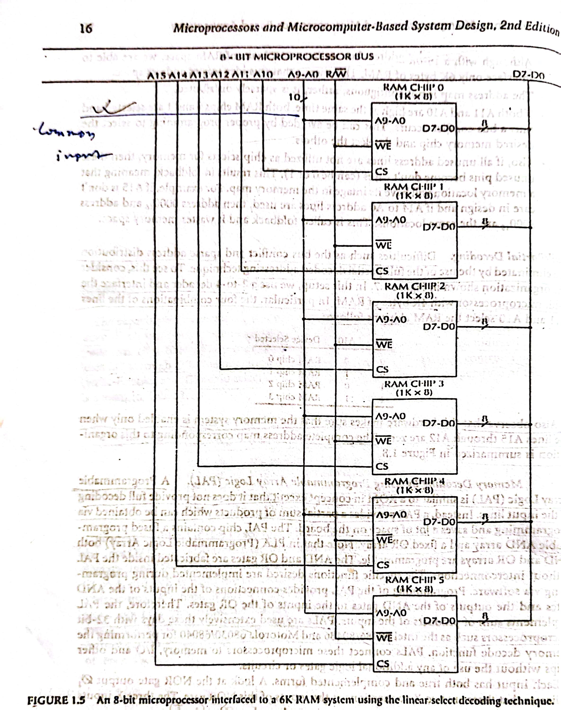

Slide 15
For Example,
If A₁₅ A₁₄ A₁₃ A₁₂ A₁₁ A₁₀ = 000010
Then chip 1 is selected.
The address map realized by this argument is summarized in
another figure.
This method is called linear select decoding technique.

Slide 16
Address Map realized by the system
Binary address pattern A₁₅ A₁₄ A₁₃ A₁₂ A₁₁ A₁₀ A₉ A₈ A₇ A₆ A₅ A₄ A₃ A₂ A₁ A₀ | Device Selected | Address arranged in Hex
0 0 0 0 0 1 0 0 0 0 0 0 0 0 0 0 0 0 0 0 0 1 1 1 1 1 1 1 1 1 1 1 | RAM Chip 0 | 0400 To 07FF
0 0 0 0 1 0 0 0 0 0 0 0 0 0 0 0 0 0 0 0 1 0 1 1 1 1 1 1 1 1 1 1 | RAM Chip 1 | 0800 To 0BFF
0 0 0 1 0 0 0 0 0 0 0 0 0 0 0 0 0 0 0 1 0 0 1 1 1 1 1 1 1 1 1 1 | RAM Chip 2 | 1000 To 13FF
0 0 1 0 0 0 0 0 0 0 0 0 0 0 0 0 0 1 0 0 0 0 1 1 1 1 1 1 1 1 1 | RAM Chip 3 | 2000 To 23FF
 | RAM Chip 4
 | RAM Chip 5

Slide 17
Advantages: The principal advantage of this method is that it
does not require any decoding hardware.
Disadvantage:
64K bytes of RAM space, interface only 6 K (Wastage address
space).
Address map is not contiguous, it is sparsely distributed.
If both A₁₁ & A₁₂ high at the same time, bus conflict occurs.
(Remedy : Proper programming to select chip
the desired memory chip and deselect the others)
If all unused address lines are not utilized as CS for memory,
then unused pins don’t care (Can be 0 or 1).

Slide 18
Full / Partial Decoding
Difficulties (Bus conflict & space address) are eliminated
by the use of the full / partial decoded addressing technique.
Consider the organization as below:

Slide 19
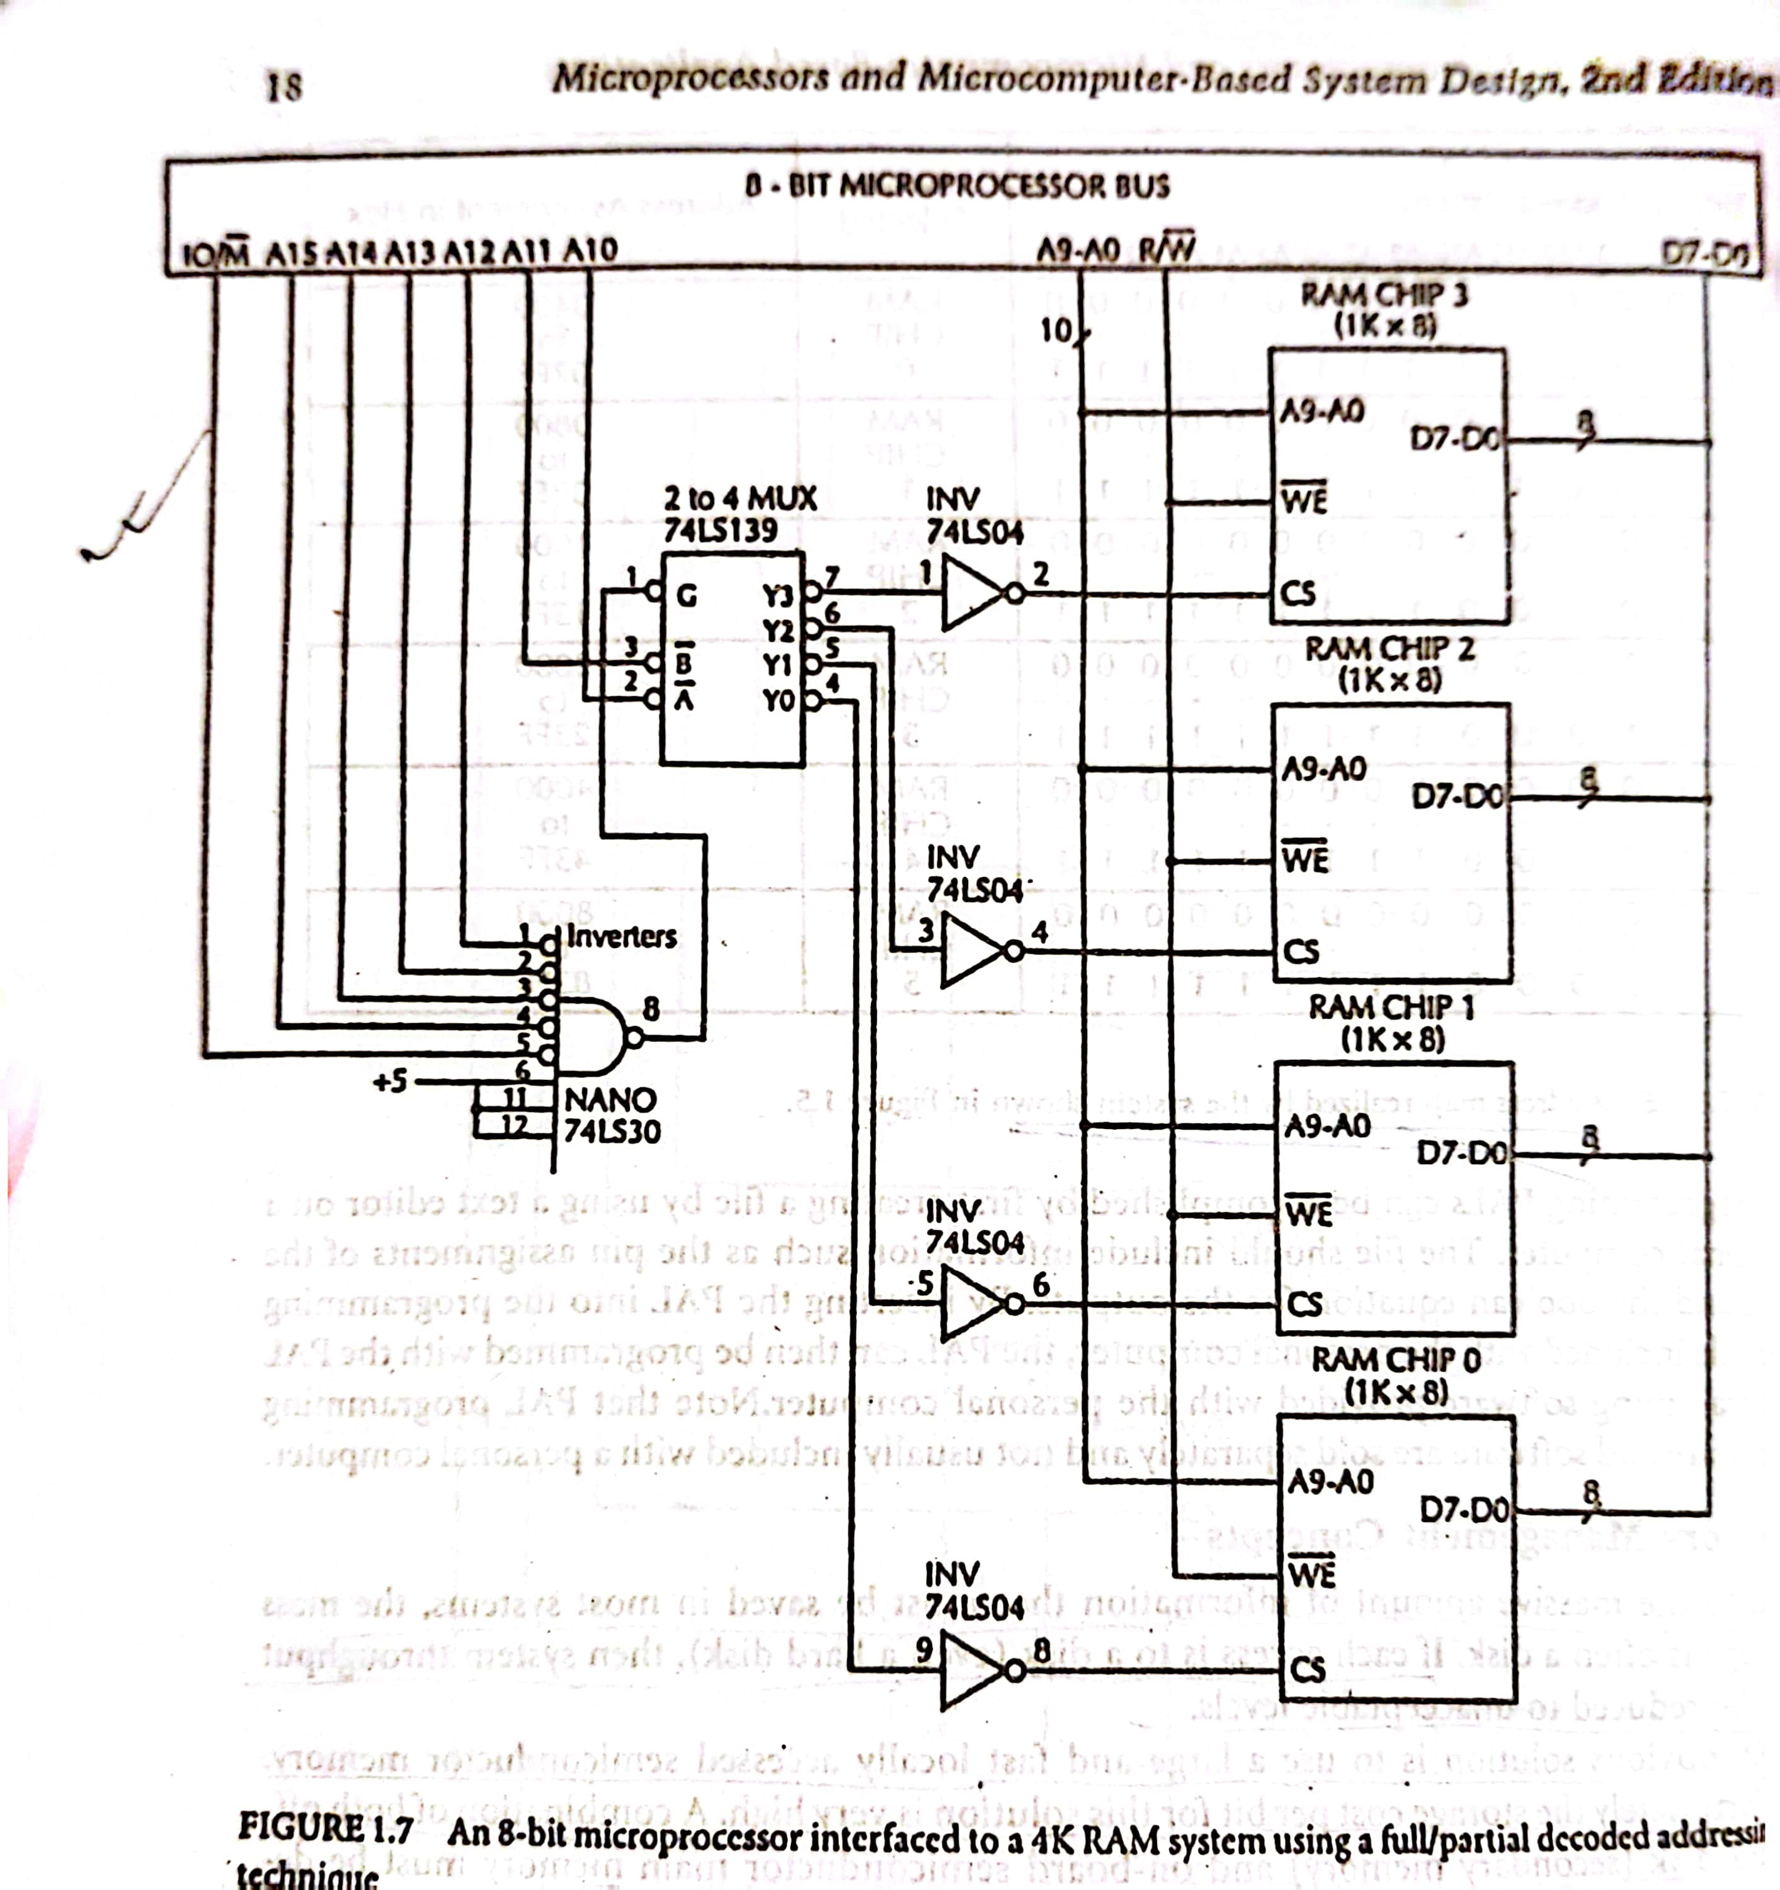

Slide 20
Here 2- to- 4 decoder is used and interface the 8 bit
microprocessor with 4K bytes of RAM.
In particular, the four combinations of the lines
A11 & A10 select the RAM chips as follow:
A11 | A10 | Device Selected
0 | 0 | RAM chip 0
0 | 1 | RAM chip 1
1 | 0 | RAM chip 2
1 | 1 | RAM chip 3

Slide 21
Also observe that this hardware makes sure that the memory system is enabled only when the lines A_{15­} through A₁₂ are Zero.
The complete address map corresponding to this organization is summarized below.

Slide 22
Binary address pattern A₁₅ A₁₄ A₁₃ A₁₂ A₁₁ A₁₀ A₉ A₈ A₇ A₆ A₅ A₄ A₃ A₂ A₁ A₀ | Device Selected | Address arranged in Hex
0 0 0 0 0 0 0 0 0 0 0 0 0 0 0 0 0 0 0 0 0 0 1 1 1 1 1 1 1 1 1 1 | RAM Chip 0 | 0000 To 03FF
0 0 0 0 0 1 0 0 0 0 0 0 0 0 0 0 0 0 0 0 0 1 1 1 1 1 1 1 1 1 1 1 | RAM Chip 1 | 0400 To 07FF
0 0 0 0 1 0 0 0 0 0 0 0 0 0 0 0 0 0 0 0 1 0 1 1 1 1 1 1 1 1 1 1 | RAM Chip 2 | 0800 To 0BFF
0 0 0 0 1 1 0 0 0 0 0 0 0 0 0 0 0 0 0 0 1 1 1 1 1 1 1 1 1 1 1 1 | RAM Chip 3 | 0C00 To 0FFF

Slide 23
Memory Management Cocepts
Due to the massive amount of information that must be saved in
most systems, the mass storage is often a disk.
If each access to a disk (hard disk), system throughput
reduce to unacceptable levels.
Obvious solution: large and fast locally accessed semiconductor
Memory
Unfortunately storage cost per bit is very high.
A combination of both off board disk (secondary memory) and
on board semiconductor must be designed into a system.

Slide 24
This requires a mechanism to manage the two way flow of
information bet^{n} the primary & secondary media.
This mechanism must be able to transfer blocks of data
efficiently,
keep track of block usage, and replace them in a non
arbitrary way.
An O/S must have resource protection from corruption or
abuse by others.
Users must be able to protect areas of code from each other,
while maintaining the ability to communicate and share other
areas of code.
All these requirements indicate the need for a device, located
Between microprocessor and memory, to control access
perform address mapping, and act as an interface between
logical (program memory) and microprocessor Physical (memory)
address spaces.

Slide 25
Since this device must manage memory use, it is called the
memory management unit (MMU).
Typical 32-bit microprocessor (Motorola 68030 & Intel 80386)
include on chip MMU.
The MMU reduces the burden of the memory management
function of the O/S.
The basic function provided by the MMU are
Address translation &
Protection

Slide 26
The MMU translates these logical addresses to physical
addresses provided by the memory chips.
The MMU can perform address translation in one of two ways:
Using substitution technique
By adding an offset to each logical address to obtain the
corresponding physical address.
Logical Address
Physical Address
Address translation using substitution technique.

Slide 27
Address translation using offset technique.
+
Logical
Address
OFFSET
Physical
Address
Substitution → faster than offset method.
Offset method has the advantage of mapping a logical address to
physical address by the offset value.

Slide 28
Computer Hardware Organization
CPU
Registers
RAM | ROM
program
data
storage
storage
Control, data, address bus
ALU
Control
unit
output
input
unit
unit

Slide 29
Registers
Register is a storage location in the CPU
Used to hold data/address during execution of an instruction
Registers have faster access time than memory
Number of registers available for programming varies from μP to μP

Slide 30
Arithmetic Logic Unit (ALU)
ALU does all arithmetic and logical operations
ALU receives data from registers/memory and performs the task
ALU writes the result back to register/memory

Slide 31
Control unit
Contains hardware instruction logic
Decodes and monitors execution of instructions
CPU
Registers
RAM | ROM
program
data
storage
storage
Control, data, address bus
ALU
Control
unit
output
input
unit
unit

Slide 32
Bus
Wires through which data and information are interchanged between units
Three types of bus (more later):
  - Address bus - Data bus - Control bus
CPU
Registers
RAM | ROM
program
data
storage
storage
Control, data, address bus
ALU
Control
unit
output
input
unit
unit

Slide 33
Program counter(PC)
  Register within CPU
  Holds the address of the next instruction to be fetched from memory
  Goes through step by step counting sequence - causes the computer to read successive instruction stored in memory
  PC is modified with new address when there is a jump or transfer or subroutine call instruction
  example

Slide 34

CPU
Program memory
Data memory
A
Stack
B
Status register
IX
SP
PC
Control, data, address bus
ALU
Control unit

Slide 35
Status register
After an ALU operation following can occur
-carry/borrow for addition/subtraction
-overflow
-result zero, negative or positive
Register which contains flags to indicate these status of any processor operation
Programmer can use these status condition for program control
example

Slide 36
Flags
Carry flag
0 0 1 1 0 1 0 1
0 1 0 0 0 0 1 1
0 0 1 1 1 1 0 0 0
1 0 0 0 0 0 1 0
1 0 1 0 0 0 1 1
1 0 0 1 0 0 1 0 1
Carry 0
Carry 1

Slide 37
Index register
Almost all μPs have an index register
Holds a base address to be added to an offset
Base address and the offset forms the effective address
example

Slide 38

Effective address
Program
memory
CPU
Data
memory
A
Offset
address
B
Status register
+
Base address
Stack
IX
SP
PC
Control, data, address bus
ALU
Control unit

Slide 39
Stack pointer (SP)
An area of RAM used for temporary storage of data/return address is called stack
SP is a register within CPU that points to the next free location on the stack
Each time a byte is put onto stack, SP is decremented
Each time a byte is retrieved from stack, SP is incremented
example

Slide 40

CPU
Program memory
Data memory
A
Stack
B
Status register
IX
SP
PC
Control, data, address bus
ALU
Control unit

Slide 41

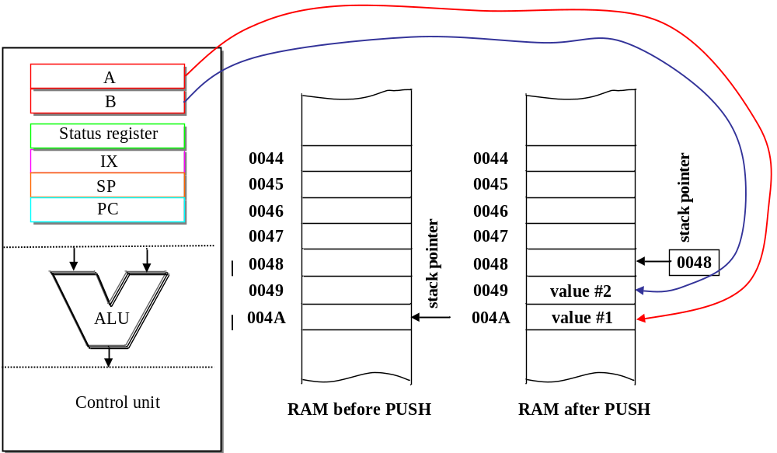

Slide 42

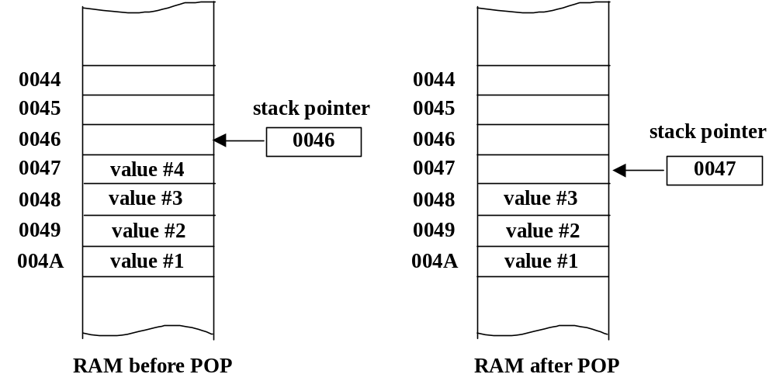

Slide 43
Instruction set
To program a μP, a variety of data manipulation, arithmetic and logical instructions are featured for a processor
Instructions can be organised into functional groups
-Data movement -Arithmetic
-Logical -Bit manipulation
-Shift/rotate -Branch/Jump
-Subroutine call -Interrupt handling
-Miscellaneous
More detail later (for a specific processor)

Slide 44
Addressing modes
To perform an operation, operands are to be supplied
Operands can come from registers, memory locations or directly as part of an instruction
Addressing mode says from where the operands come from
Very common addressing modes are
-Immediate, direct, inherent, relative, indexed (more detail later)

Slide 45
Memory
Random Access Memory (RAM)
SRAM: static RAM – uses bipolar transistors (4-6) and very fast but expensive
DRAM: dynamic RAM – uses one transistor and one capacitor – information stored in capacitor – periodic refresh operation required

Slide 46
Memory
Read Only Memory (ROM)
Mask-programmed read-only memory (MROM): programmed when being manufactured
Programmable read-only memory (PROM): the memory chip can be programmed by the end user
  EPROM: programmable memory that can be erased
  EEPROM: programmable memory that can be erased by electrical signals and reprogrammed

Slide 47
Program
A program is sequence of instructions
A program can be written in
  Low level language e.g. assembly language
  High level language e.g. C, PASCAL
Assembly language program is converted to machine code by an assembler
High level language is translated into machine code by a compiler

Slide 48
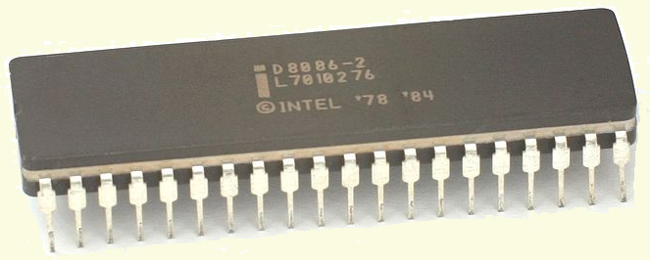
Intel 8086 Microprocessor
Key Features:
Released by Intel in 1978
Produced from 1978 to 1990s
A 16-bit microprocessor chip.
Max. CPU clock rate :
5 MHz to 10 MHz
Package: 40 pin DIP
Fig1:Intel 8086 Microprocessor

Slide 49
8086 microprocessor
Address Bus – 20 lines – A₁₉ – A₀
Add
Bus
Data Bus – 16 lines – D₁₅ – D₀
Data
Bus
Microprocessor
8086
16 bit- microprocessor ?
16-bits data bus?
Control
signals

Slide 50
20 bits address bus?
It can address any one of 1,048,576 (=2²⁰ ) memory locations/addresses.
Each memory location is one byte wide.
To store a word of 16 bit 2 memory locations are required.
If the first byte of the word is at even address 8086 can read the entire word in one operation.
If the first byte of the word is at an odd address, the 8086 will read the first byte with one bus operation and the second byte with another bus operation.
A₁₉……………A₀
0……………….0
00000H
1……………….1
FFFFFH
00000H
Memory
Address
Space
1,048,576 memory locations=1MBytes
FFFFFH

Slide 51
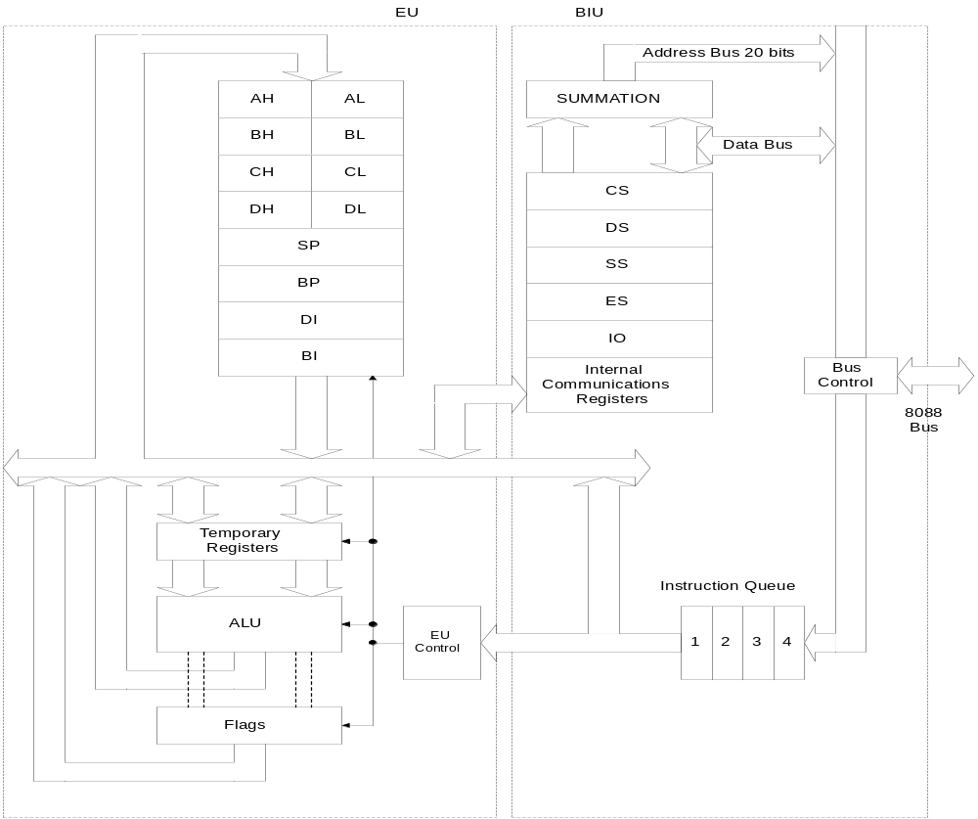
8086/8088 Internal Organisation

Slide 52
Main registers
AH |  |  |  |  |  |  |  | AL |  |  |  |  |  |  |  | AX (primary accumulator)
BH |  |  |  |  |  |  |  | BL |  |  |  |  |  |  |  | BX (base, accumulator)
CH |  |  |  |  |  |  |  | CL |  |  |  |  |  |  |  | CX (counter, accumulator)
DH |  |  |  |  |  |  |  | DL |  |  |  |  |  |  |  | DX (accumulator, other functions)
Index registers
SI |  |  |  |  |  |  |  |  |  |  |  |  |  |  |  | Source Index
DI |  |  |  |  |  |  |  |  |  |  |  |  |  |  |  | Destination Index
BP |  |  |  |  |  |  |  |  |  |  |  |  |  |  |  | Base Pointer
SP |  |  |  |  |  |  |  |  |  |  |  |  |  |  |  | Stack Pointer
Status register
15 | 14 | 13 | 12 | 11 | 10 | 9 | 8 | 7 | 6 | 5 | 4 | 3 | 2 | 1 | 0 | (bit position)
- | - | - | - | O | D | I | T | S | Z | - | A | - | P | - | C | Flags
Segment register
CS |  |  |  |  |  |  |  |  |  |  |  |  |  |  |  | Code Segment
DS |  |  |  |  |  |  |  |  |  |  |  |  |  |  |  | Data Segment
ES |  |  |  |  |  |  |  |  |  |  |  |  |  |  |  | ExtraSegment
SS |  |  |  |  |  |  |  |  |  |  |  |  |  |  |  | Stack Segment
Instruction pointer
IP |  |  |  |  |  |  |  |  |  |  |  |  |  |  |  | Instruction Pointer

Slide 53
BIU and EU
BIU (bus interface unit) sends out addresses, fetches instructions from memory, reads data from ports and memory, and writes data to ports and memory. In other words, the BIU handles all transfers of data and addresses on the buses for the execution unit.
EU (execution unit) of the 8086 tells the BIU where to fetch instructions or data from, decodes instructions, and executes instructions.

Slide 54
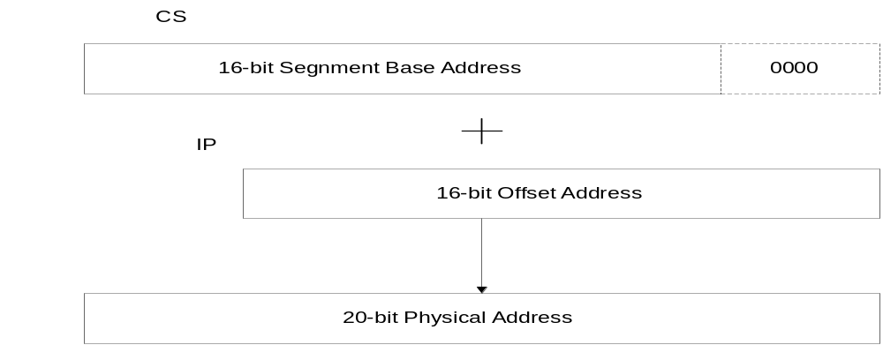
8086/8088 20-bit Addresses
The BIU computes the 20-bit physical address internally using 16 bits contents of CS and IP by logically shifting the contents of CS four bits to left and then adding the 16-bit contents of IP

Slide 55
General Purpose Registers
15
8
7
0
AX
AH
AL
Accumulator
BX
BH
BL
Base
Data Group
CX
CH
CL
Counter
DX
DH
DL
Data
SP
Stack Pointer
BP
Base Pointer
Pointer and
Index Group
SI
Source Index
DI
Destination Index
Microprocessor System Design
3-<number>

Slide 56
Arithmetic Logic Unit (ALU)
A
B
F Y
0 0 0 A + B
0 0 1 A - B
0 1 0 A - 1
0 1 1 A and B
1 0 0 A or B
1 0 1 not A
• • • • • •
n bits
n bits
Carry
Y= 0 ?
F
A > B ?
Y
Signal F control which function will be conducted by ALU.
Signal F is generated according to the current instruction.
Basic arithmetic operations: addition, subtraction, •••••
Basic logic operations: and, or, xor, shifting,•••••
Microprocessor System Design
3-<number>

Slide 57

AX
AH AL
7 0 7 0
BX
CX
AX
0
DX
1/2002
JNM

Slide 58
General Purpose Registers
AX (Accumulator) – favored by CPU for arithmetic operations
BX – Base – can hold the address of a procedure or variable (SI, DI, and BP can also). Can also perform arithmetic and data movement.
CX – acts as a counter for repeating or looping instructions.
DX – holds the high 16 bits of the product in multiply (also handles divide operations)
1/2002
JNM

Slide 59

CS
SS
CS
0
DS
ES
1/2002
JNM

Slide 60
Segment Registers
  Used as base locations for program instructions, data and the stack
CS – Code Segment – holds base location for all executable instructions in a program
SS - Base location of the stack
DS – Data Segment – default base location for variables
ES – Extra Segment – additional base location for memory variables.
1/2002
JNM

Slide 61

BP
SP
BP
0
SI
DI
1/2002
JNM

Slide 62
Index Registers
  Contain the offset of data(variables, labels) and instructions from its base segment.
BP – Base Pointer – contains an assumed offset from the SS register. Often used by a subroutine to locate variables that were passed on the stack by a calling program.
SP – Stack Pointer – Contains the offset of the top of the stack.
1/2002
JNM

Slide 63
Index Registers
  Speed up processing of strings, arrays, and other data structures containing multiple elements.
SI – Source Index – Used in string movement instructions. The source string is pointed to by the SI register.
DI – Destination Index – acts as the destination for string movement instructions
1/2002
JNM

Slide 64

IP
IP
0
Flags
1/2002
JNM

Slide 65
Status and Control Registers
IP – Instruction Pointer – contains the offset of the next instruction to be executed.
Flags Register – individual bit positions within register show status of CPU or results of arithmetic operations.
  Control Flags (Direction, Interrupt, Trap)
  Status Flags (Carry, Overflow, Sign, Zero, Auxiliary Carry, Parity)
1/2002
JNM

Slide 66
Flags - Status
Carry (CF) – set when the result of an unsigned arithmetic operation is too large to fit into the destination.
Overflow(OF) – set when the result of a signed arithmetic operation is too wide to fit into the destination.
Sign(SF) – set when the result of an arithmetic or logical operation generates a negative result.
Zero(ZF) – set when the result of an arithmetic or logical operation is zero.
1/2002
JNM

Slide 67
Flags – Status (cont)
Auxiliary Carry(AF) – set when the result of an operation causes a carry from bit 3 to bit 4.
Parity(PF) – reflects whether the number of 1 bits in the result of an operation is even or odd. 1 – odd, 0-even.
1/2002
JNM

Slide 68
Flag Register
Flag register contains information reflecting the current status of a
microprocessor. It also contains information which controls the
operation of the microprocessor.
15
0
⎯
⎯
⎯
OF
DF
IF
TF
SF
ZF
⎯
AF
⎯
PF
⎯
CF
Control Flags
Status Flags
IF: Interrupt enable flag
DF: Direction flag
TF: Trap flag
CF: Carry flag
PF: Parity flag
AF: Auxiliary carry flag
ZF: Zero flag
SF: Sign flag
OF: Overflow flag
Microprocessor System Design
3-<number>

Slide 69
Instruction Machine Codes
Instruction machine codes are binary numbers
For Example:
1 0 0 0 1 0 0 0 1 1 0 0 0 0 1 1
MOV AL, BL
MOV
Register
mode
Machine code structure
Opcode
Mode
Operand1
Operand2
Some instructions do not have operands, or have only one operand
Opcode tells what operation is to be performed.
(EU control logic generates ALU control signals according to Opcode)
Mode indicates the type of a instruction: Register type, or Memory type
Operands tell what data should be used in the operation. Operands can
be addresses telling where to get data (or where to store results)
Microprocessor System Design
3-<number>

Slide 70
Generating Memory Addresses
How can a 16-bit microprocessor generate 20-bit memory
addresses?
Left shift 4 bits
FFFFF
16-bit register
0000
Addr1 + 0FFFF
Segment
(64K)
+
16-bit register
Offset
Addr1
Offset
20-bit memory address
Segment
address
00000
Intel 80x86 memory address generation
1M memory space
Microprocessor System Design
3-<number>

Slide 71
Memory Segmentation
A segment is a 64KB block of memory starting from any 16-byte
boundary
For example: 00000, 00010, 00020, 20000, 8CE90, and E0840 are all valid
segment addresses
The requirement of starting from 16-byte boundary is due to the 4-bit
left shifting
Segment registers in BIU
15
0
CS
Code Segment
DS
Data Segment
SS
Stack Segment
ES
Extra Segment
Microprocessor System Design
3-<number>

Slide 72
Memory Address Calculation
Segment addresses must be stored
in segment registers
0000
Segment address
+
Offset
Offset is derived from the combination
of pointer registers, the Instruction
Pointer (IP), and immediate values
Memory address
Examples
CS
3
4
8
A
0
SS
5
0
0
0
0
IP
+
4
2
1
4
SP
+
F
F
E
0
Instruction address
3
8
A
B
4
Stack address
5
F
F
E
0
DS
1
2
3
4
0
DI
+
0
0
2
2
Data address
1
2
3
6
2
Microprocessor System Design
3-<number>

Slide 73
Fetching Instructions
Where to fetch the next instruction?
8088
Memory
CS
1 2 3 4
IP
0 0 1 2
12352
MOV AL, 0
1 2 3 5 2
Update IP
After an instruction is fetched, Register IP is updated as follows:
IP = IP + Length of the fetched instruction
For Example: the length of MOV AL, 0 is 2 bytes. After fetching this instruction,
the IP is updated to 0014
Microprocessor System Design
3-<number>

Slide 74
Accessing Data Memory
There is a number of methods to generate the memory address when
accessing data memory. These methods are referred to as
Addressing Modes
Examples:
Direct addressing: MOV AL, [0300H]
DS
1
2
3
4
0
(assume DS=1234H)
0
3
0
0
Memory address
1
2
6
4
0
Register indirect addressing: MOV AL, [SI]
DS
1
2
3
4
0
(assume DS=1234H)
0
3
1
0
(assume SI=0310H)
Memory address
1
2
6
5
0

Slide 75
Reserved Memory Locations
Some memory locations are reserved for special purposes.
Programs should not be loaded in these areas
FFFFF
Locations from FFFF0H to FFFFFH
are used for system reset code
Reset
instruction
area
FFFF0
Locations from 00000H to 003FFH
are used for the interrupt pointer table
Interrupt
pointer
table
It has 256 table entries
Each table entry is 4 bytes
003FF
256 × 4 = 1024 = memory addressing space
From 00000H to 003FFH
00000
Microprocessor System Design
3-<number>

Slide 76
Interrupts
An interrupt is an event that occurs while the processor is executing a program
The interrupt temporarily suspends execution of the program and switch the
processor to executing a special routine (interrupt service routine)
When the execution of interrupt service routine is complete, the processor
resumes the execution of the original program
Interrupt classification
Hardware Interrupts | Software Interrupts
Caused by activating the processor’s interrupt control signals (NMI, INTR) | Caused by the execution of an INT instruction Caused by an event which is generated by the execution of a program, such as division by zero
8088 can have 256 interrupts
Microprocessor System Design
3-<number>

Slide 77
Minimum and Maximum Operation modes
Intel (8086) has two operation modes:
Minimum Mode Maximum Mode
8086 generates control signals
for memory and I/O operations
It needs 8288 bus controller to generate
control signals for memory and I/O
operations
Some functions are not available
in minimum mode
It allows the use of 8087 coprocessor;
it also provides other functions
Microprocessor System Design
3-<number>

Slide 78
BIU Elements
Instruction Queue: the next instructions or data can be fetched from memory while the processor is executing the current instruction
  The memory interface is slower than the processor execution time so this speeds up overall performance
Segment Registers:
  CS, DS, SS and ES are 16b registers
  Used with the 16b Base registers to generate the 20b address
  Allow the 8086/8088 to address 1MB of memory
  Changed under program control to point to different segments as a program executes
Instruction Pointer (IP) contains the Offset Address of the next instruction, the distance in bytes from the address given by the current CS register

Slide 79
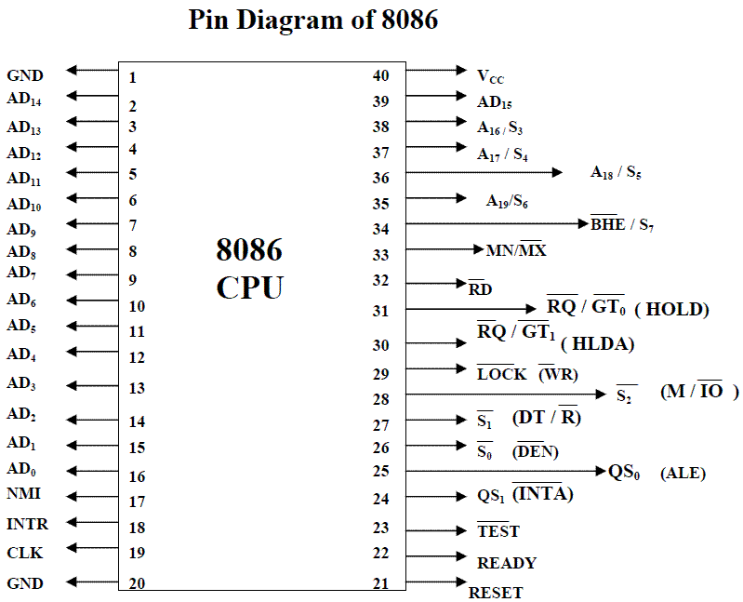
Figure shows the Pin diagram of 8086. The description follows it.

Slide 80
8086 Pin Description
Vcc (pin 40) : Power
Gnd (pin 1 and 20) : Ground
AD0..AD7 , A8..A15 , A19/S6, A18/S5, A17/S4, A16/S3 : 20 -bit Address Bus
MN/MX’ (input) : Indicates Operating mode
READY (input , Active High) : take uP to wait state
CLK (input) : Provides basic timing for the processor
RESET (input, Active High) : At least 4 clock cycles Causes the uP immediately
terminate its present activity.
TEST’ (input , Active Low) : Connect this to HIGH
HOLD (input , Active High) : Connect this to LOW
HLDA (output , Active High) : Hold Ack
INTR (input , Active High) : Interrupt request
INTA’ (output , Active Low) : Interrupt Acknowledge
NMI (input , Active High) : Non-maskable interrupt

Slide 81
8086 Pin Description
DEN’ (output) : Data Enable. It is LOW when processor wants to
receive data or processor is giving out data (to74245)
DT/R’ (output) : Data Transmit/Receive.
When High, data from uP to memory
  When Low, data is from memory to uP (to74245 dir)
IO/M’ (output) : If High uP access I/O Device.
If Low uP access memory
RD’ (output) : When Low, uP is performing a read operation
WR’ (output) : When Low, uP is performing a write operation
ALE (output) : Address Latch Enable , Active High
Provided by uP to latch address
When HIGH, uP is using AD0..AD7, A19/S6,
A18/S5, A17/S4, A16/S3 as address lines

Slide 82
The Microprocessor 8086 is a 16-bit CPU available in different clock rates and packaged in a 40 pin CERDIP or plastic package.
The 8086 operates in single processor or multiprocessor configuration to achieve high performance. The pins serve a particular function in minimum mode (single processor mode ) and other function in maximum mode configuration (multiprocessor mode ).
The 8086 signals can be categorised in three groups.
  The first are the signal having common functions in minimum as well as maximum mode.
  The second are the signals which have special functions for minimum mode
  The third are the signals having special functions for maximum mode.
The following signal descriptions are common for both modes.
AD15-AD0 : These are the time multiplexed memory I/O address and data lines.
  Address remains on the lines during T1 state, while the data is available on the data bus during T2, T3, Tw and T4. These lines are active high and float to a tristate during interrupt acknowledge and local bus hold acknowledge cycles.

